Slide 1
Data Visualization Associate Early Internship
A Journey Through Data Cleaning, Processing, and Visualization

Slide 2
team 22b | 0303 dva
Team Lead
Wamiq Ejaz
Project Leads
Areeba Fatima & Varun D
Project Scribe
Sakshi Gollar
Project Manager
Shivani Galande

Slide 3
Introduction
Internship Overview
This is a Virtual internship focusing on real-world data analysis.
Goal
Extraction, cleaning and structuring data to prepare it for visualization via dashboard.

Slide 4
Objective
The project aims to clean, transform, and visualize data in a structured manner, enabling better decisions through a well-organized master table and interactive dashboard. By streamlining data processes and improving visualization techniques, the project provides a solution for data-driven decision-making.

Slide 5
Week 1 – Data Exploration & Cleaning
Objectives: Understand the 6 datasets, cleaning raw data, and perform exploratory data analysis (EDA).
Key activities: Data familiarization, handling missing values, duplicates, and inconsistencies, generating summary statistics and reporting via EDA

Slide 6
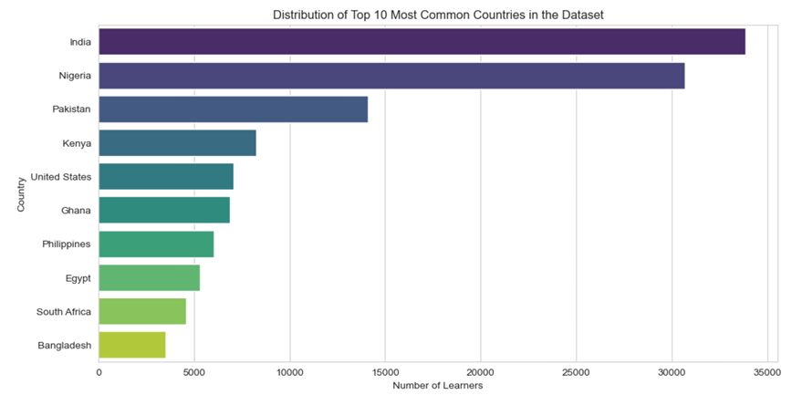
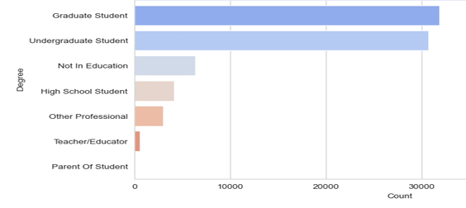
Results
Country wise Representation
Education Level

Slide 7
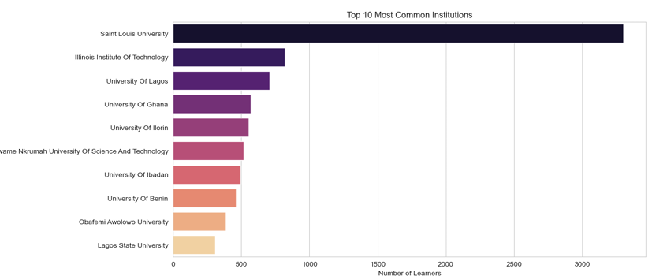
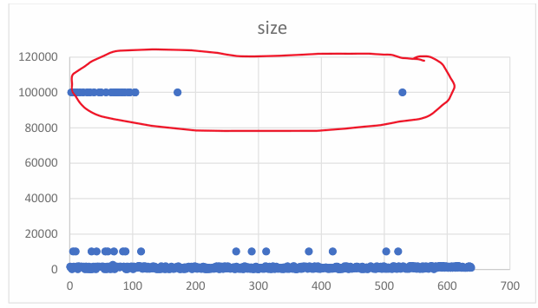
Results
Inconsistent Data
Most Common Institutes

Slide 8
Week 2 – Data Structuring & Transformation
Objective
Create a structured dataset ready for analysis by defining relationships and refining data quality.
Data Issues Analysis
Identified missing values, duplicates, and inconsistencies.
ETL Process Development
Extracted, cleaned, and loaded data into a Master Table.
Master Table Validation
Ensured accuracy and completenes.
Documentation
Summarized findings, fixes, and final data quality.
Outcome
A structured and validated dataset ready for visualization

Slide 9
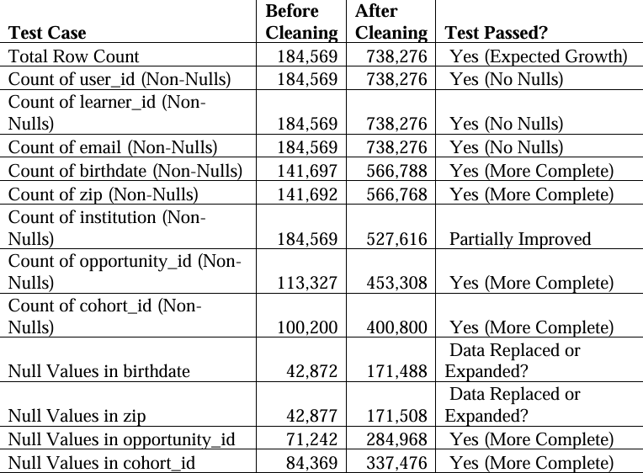
Result

Slide 10
Week 3 – Dashboard Planning & Design
Objective: Develop a visualization strategy and design a structured dashboard.
Mapping Table Creation: Defined key relationships, data points, and business logic.
Metric & KPI Identification: Selected indicators essential for decision-making.
Wireframe Development: Designed the layout of the dashboard, including KPIs, charts, and tables.
Annotations & Justification: Explained the reasoning behind visualization choices.
Outcome: A clear blueprint for dashboard implementation, ensuring effective data representation.

Slide 11
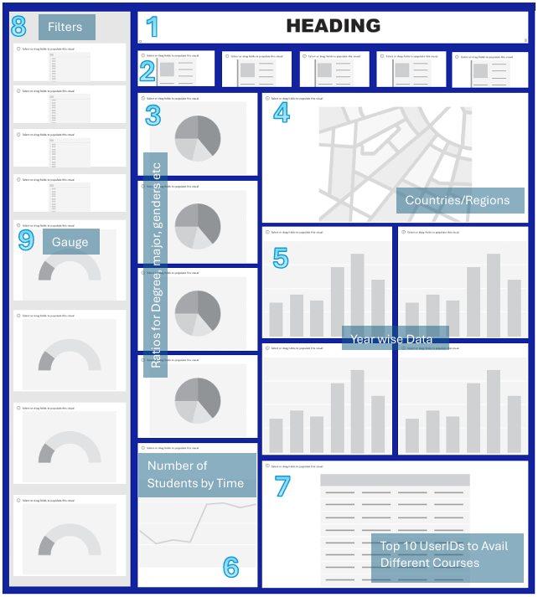
Result
Identifying KPIs
And
DESIGNING WIREFRAME
WITH
ANNOTATIONS

Slide 12
Week 4 – Dashboard Implementation & Insights
Objective: Implement the dashboard, analyze key trends, and derive actionable insights.
Key Activities:
Final data transformation, Dashboard development in Looker Studio, Extraction of key insights
Outcomes:
A fully functional interactive dashboard showcasing trends.

Slide 13
Dashboard
Key sections: KPIs, trends, geographical data, and student demographics.
These are implemented in the Dashboard
https://lookerstudio.google.com/reporting/0cb13429-d263-47a1-8ba4-c9b0549f9ea5

Slide 14
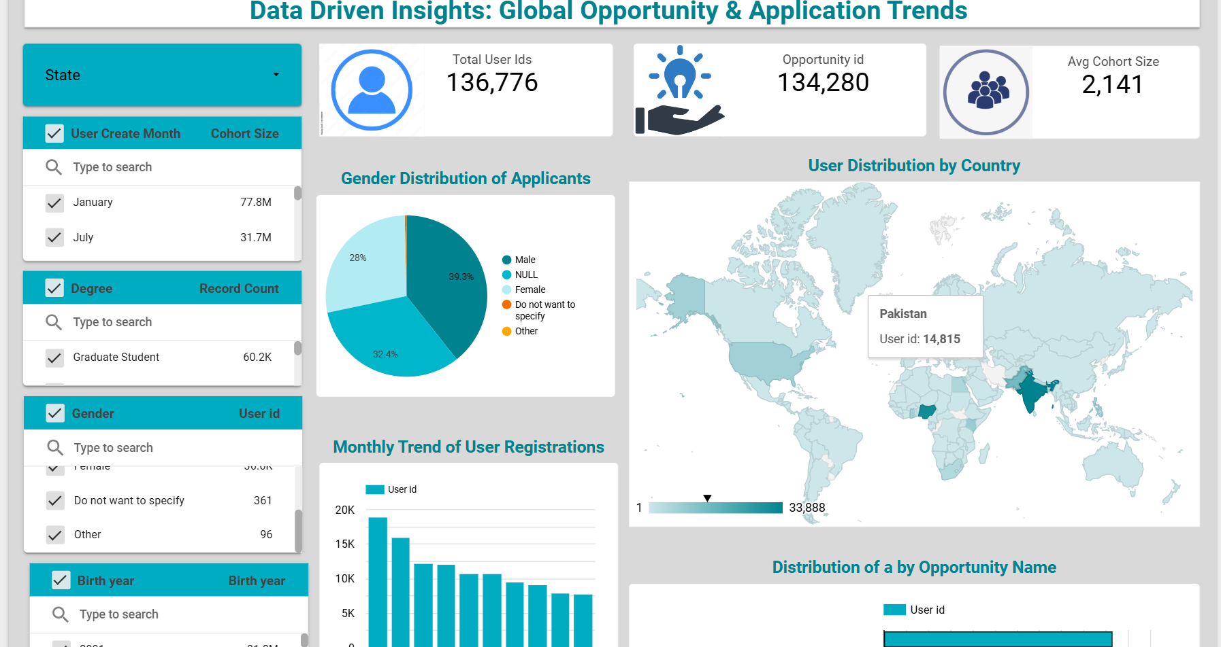
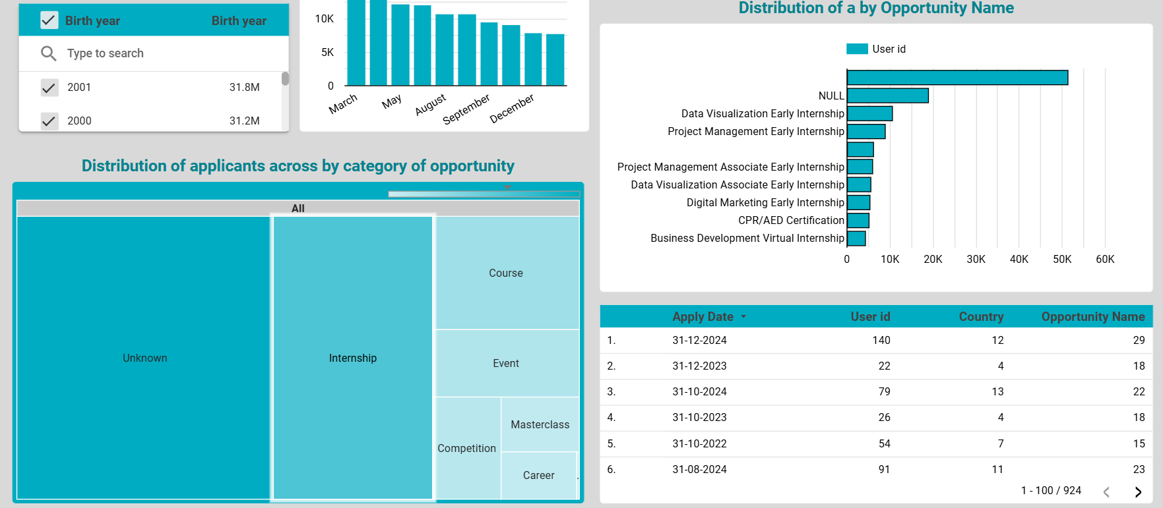

Slide 15
Actionable Recommendations
Improve Data Collection: Address missing gender and opportunity category values to ensure accurate reporting.
Optimize Opportunity Offerings: Promote opportunities with lower engagement to balance interest across categories.
Target Marketing Efforts: Since user registrations peak in specific months, align marketing campaigns accordingly.
Expand Geographical Reach: Leverage insights from country-wise distribution to attract applicants from underrepresented regions.

Slide 16
Challenges & Learnings
WEEK 01
WEEK 02
WEEK 03
WEEK 04
EDA
Master Table
Wire Frame
Presentation
Handling large datasets with missing values.
Validating relationships between datasets, and merging them in a Master Table
Planning out the annotations.
Designing a user-friendly and insightful dashboard

Slide 17
At last we sincerely appreciate the opportunity provided by Excelerate to work on this project. This internship has been an incredible learning experience, allowing us to apply data analytics concepts to real-world scenarios. Thank you to our mentors, peers, and the entire Excelerate team for their guidance and support throughout this journey.
Thank You!

